Slide 1
Embeddings w/ node classification

Slide 2
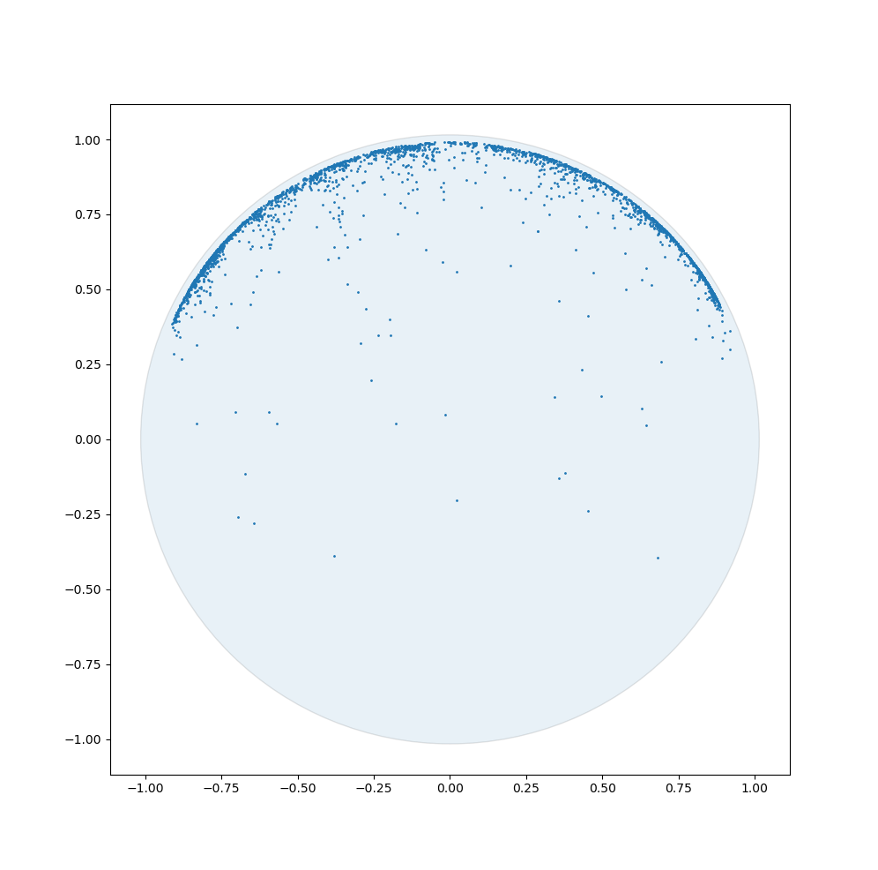
Disease- Link Prediction Only

Slide 3
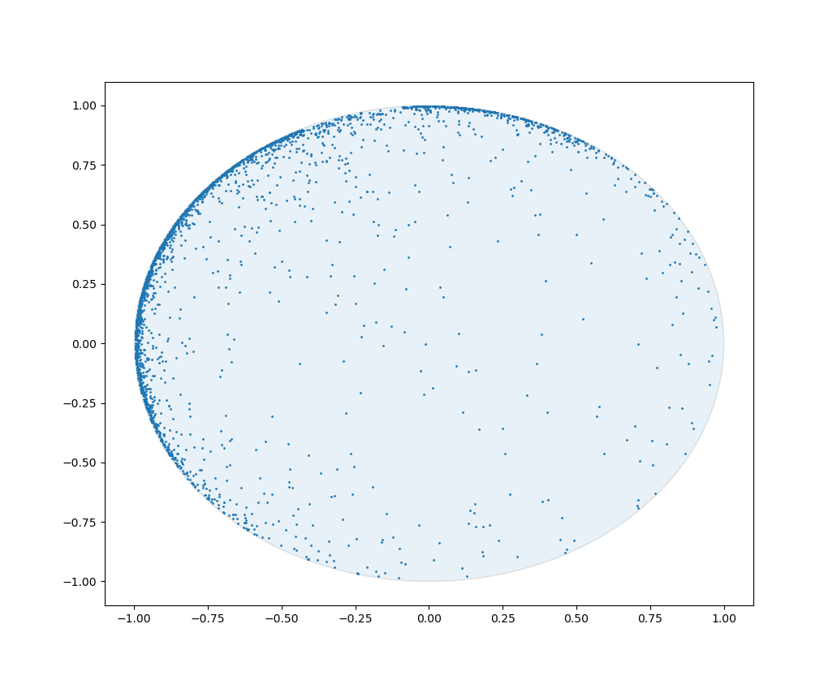
Disease- Node Classification Only

Slide 4
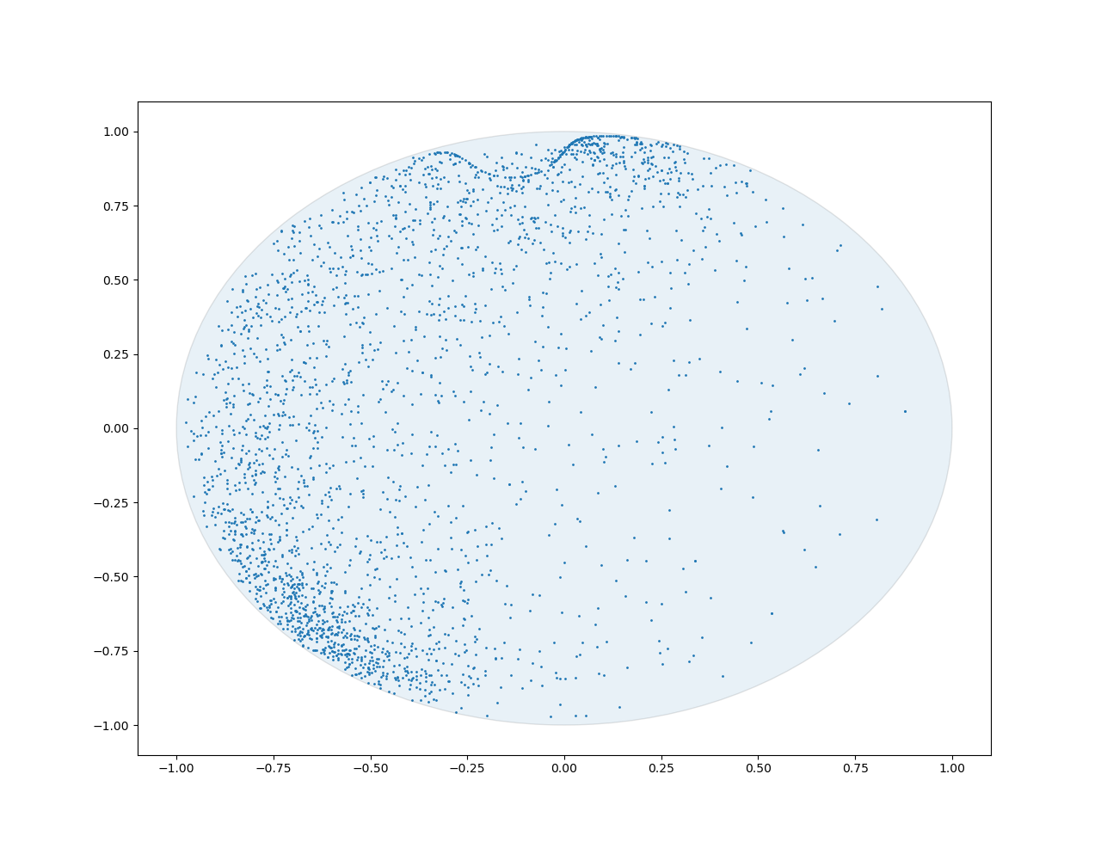
Disease Classification + Link Prediction

Slide 5
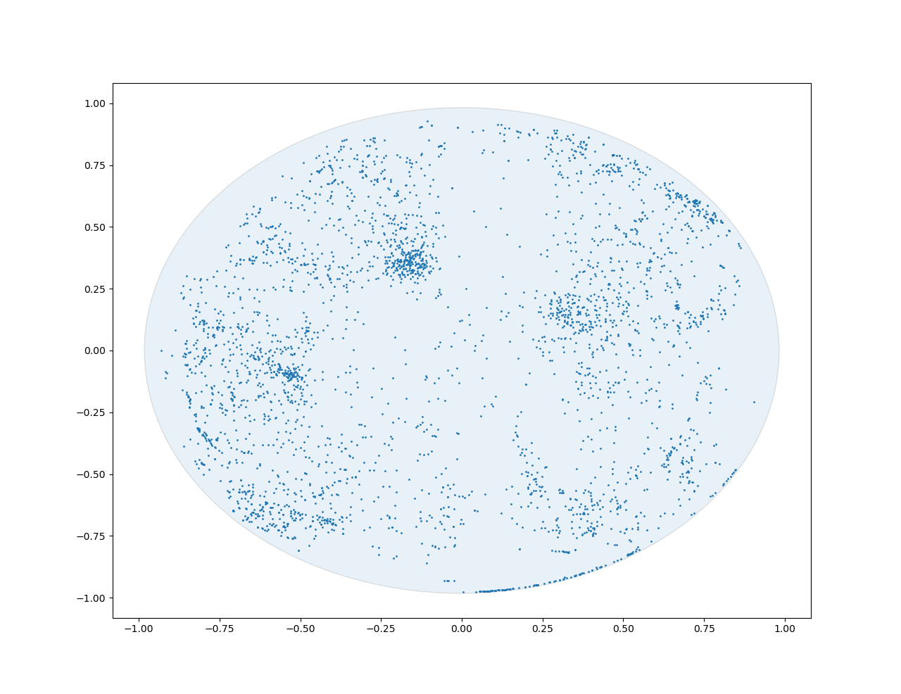
Airport- Link Prediction Only

Slide 6
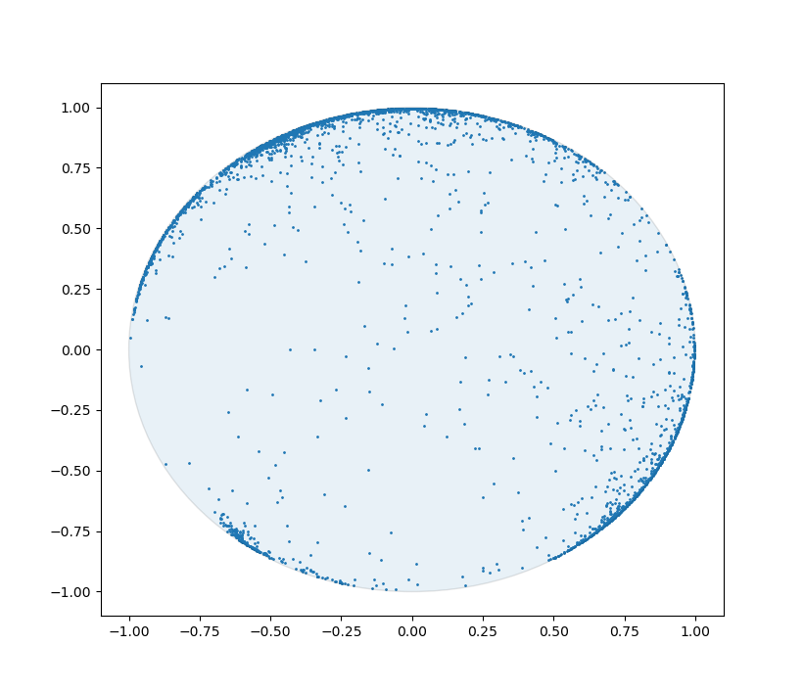
Airport- Node Classification Only

Slide 7
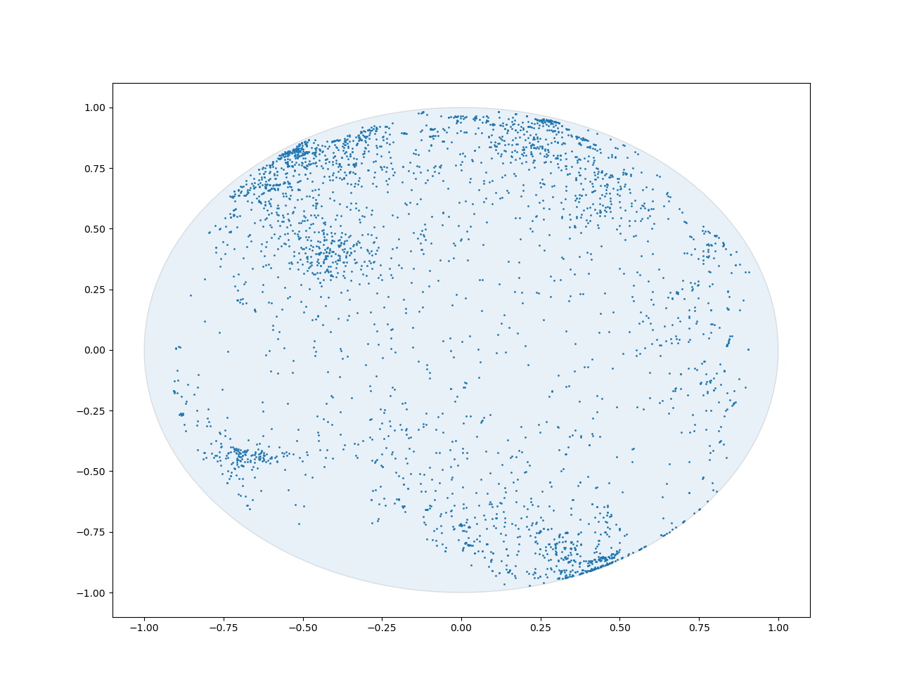
Airport Node Classification + Link Prediction

Slide 8
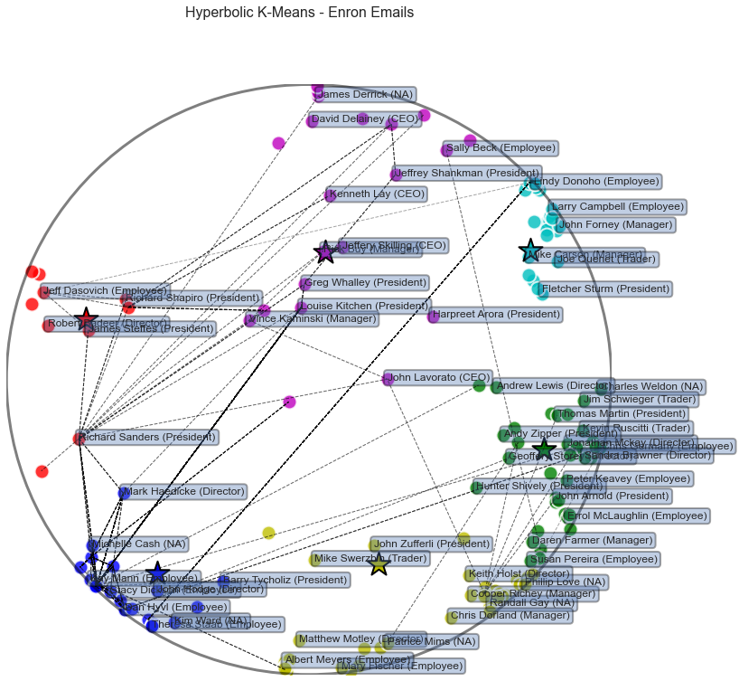
Enron Embedding w/ cluster (Nickel Poincare) from Mengjia

Slide 9
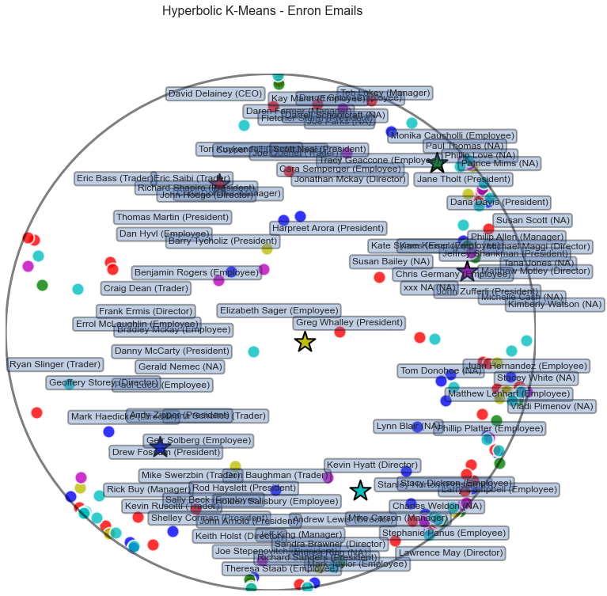
Enron Embedding w/ cluster (HGNN)
I don’t fully understand where the plot came from. I’m assuming the colors come from clustering my embeddings. The actual coords of the dots are the same as Mengjia’s plot- so I’m not sure what those are from.

Slide 10
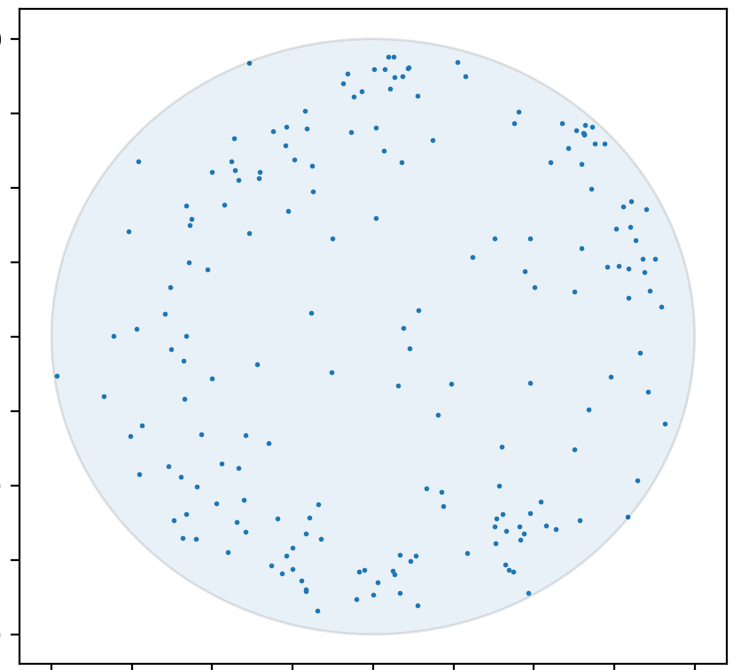
Enron Embeddings HGCNN

